Slide 1
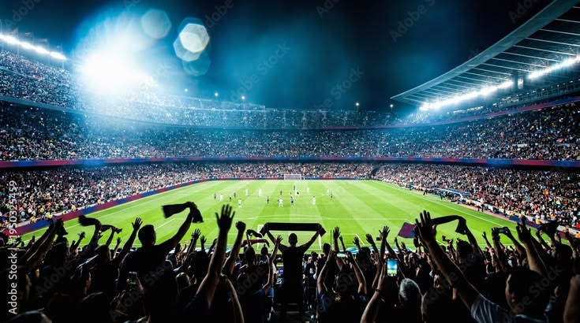
Beyond the Scoreboard
Fans are not all the same 🛒 Spending | 📱 Engagement | 🎟 Attendance | 📺 Viewing Habits

Slide 2
Data & Approach
Data | Approach
👥 2,200 Fans | Raw Data
🌍 15 Countries | ↓
⚽ 26 Sports | Feature Selection
 | ↓
 | Clustering
 | ↓
 | Fan Segments

Slide 3
What the Data Revealed
5 Behavioral Clusters → Grouped into 3 Fan Personas
🏆 Premium | 📱 Digital | ⚽ Casual
High Spending | Online Engagement | Occasional Engagement
High Loyalty | Low Event Attendance | Event-Driven Participation

Slide 4
Why This Matters in Real Life
Who benefits:
🏟 Sports organizations
📺 Streaming platforms
🎯 Marketing teams
🎪 Event organizers
👕 Sports brands

Slide 5
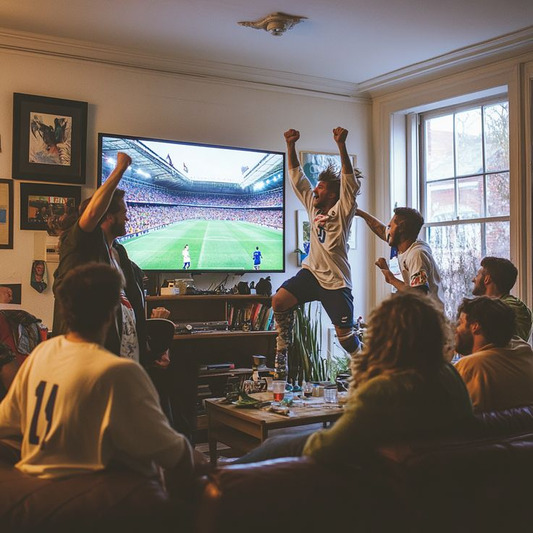
One Event. Many Types of Fans.
Before Data Science:
👥 A Crowd
After Data Science:
👥 → 🏆 📱 ⚽

